Slide 1

Smart Student Academic Assistant
Group members
Bhavya Sharma-2510530423
Samriddhi Gaur. -2510320436
Nisha Rana. -2510320527
Mentor: Shivani Sharma
Course : BCA
Semester : 3rd
Department : Computer Science
Graphic era Deemed University.
Page NO. -1

Slide 2
Introduction
Students have to manage marks, assignments, deadlines and study topics during their ongoing semester.
This information is often maintained separately in notebooks, ERP , class whatsapp groups or other applications.
It can become difficult to decide which subject needs more attention and which task should be completed first.
Our project brings all these activities together in one system.
The system uses Data Structures and Algorithms in C to organize and process academic information.
It also provides rule-based study recommendations based on marks, deadlines and topic status.
Page No.-2

Slide 3

Problem Statement
Problem Statement
Students at present manage different academic activities separately, such as:
Subject marks and performance
Assignments and deadlines
Pending study tasks
Study topics and their completion status
Recently studied topics
Topic prerequisites
Page No.-3

Slide 4

Problems faced:
Academic information is scattered.
Students may not know which subject may needs more attention.
Assignments may be completed without considering their urgency.
Prerequisite topics may be skipped.
There is no single place to view academic priorities.
Our Problem:
How can we organize student academic information and use DSA-based processing to help students identify priorities and plan their studies?
Page No.-4

Slide 5
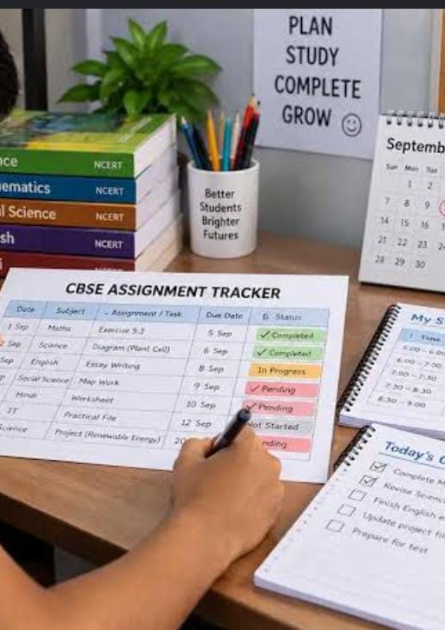
Objectives
To maintain student and subject academic information.
To store and analyse subject marks.
To identify subjects that require more attention.
To manage assignments according to deadline and priority.
To maintain pending and completed study tasks.
To keep track of recently studied topics.
To represent topic prerequisites using a graph.
To provide simple rule-based study recommendations.
To provide all important information through a single dashboard.
To demonstrate practical use of Data Structures and Algorithms in C.
Page no.-5

Slide 6
.
Literature review
Existing Approach | What it Provides | Limitation
ERP portal | Marks and academic records | Limited study planning
To-Do / Task Apps | Task and deadline management | Usually not based on academic performance
Calendar Applications | Reminders and schedules | Do not analyse weak subjects
Student Management Systems | Student information | Mostly focused on record management
DSA-based Systems | Efficient data organization | Usually designed for specific algorithmic problems
Observation
Existing tools provide individual solutions, but our project combines all these in one single system.
Page no.-6

Slide 7

Proposed Methodology
Student Input
Academic Data Collection
Data Storage
DSA-Based Processing
Academic Analysis
Rule-Based Recommendations
Dashboard / Results
We will:
1. Collect Data
2. Store Data
3. Process Data
4. Apply Algorithms
5. Generate Results
Page No.-7

Slide 8

Tools & Technologies Used
Technology | Purpose
C | Data Structures, algorithms and core processing
HTML | Webpage structure
CSS | Interface design and layout
JavaScript | Frontend interaction
Python Flask | Backend/API
SQLite | Database and data storage
VS Code / Codeblock | C Development
Web Browser | Running and testing frontend
DSA Used
Array
Structure
Linked List
Queue
Priority Queue
Stack
Graph
Algorithms Used
Linear Search
Binary Search
Bubble Sort
BFS
DFS
Rule-based recommendation
Page No.-8

Slide 9
System architecture
Student(Enter\view information)
Frontend HTML+ CSS+ JavaScript (dashboard, profile, marks, assignments, study planner, recommendations, topic dependencies)
DSA processing C DSA engine (Arrays/structures, linked list, queue, priority, Queue, stack, graph, search/sort/BFS/DFS)
Academic analysis. (weak subject detection, assignment, priority, topic learning path, Study history, recommendations)
Database operations SQLite (student, subjects,, assignment assignments, topics, study history)
Backend. (Python flask)
Results. Priority task. Week subjects. Suggested topics. Learning path.
System Architecture
Page NO.-9

Slide 10

Expected Outcome
After implementation, we expect the system to:
Provide a single dashboard for academic information.
Show subject-wise performance.
Identify subjects which require more attention.
Arrange assignments according to their priority.
Maintaining pending and completed study tasks.
Display recently studied topics.
Show topic prerequisites and learning paths.
Provide simple rule-based study recommendations.
Store academic information using SQLite.
Demonstrate practical implementation of DSA in C.
Example
Mathematics → 55 marks → HIGH STUDY PRIORITY
Assignment → Due Tomorrow → HIGH PRIORITY
Prerequisite Incomplete → Study prerequisite first
Page No.-10

Slide 11
Team Member contrubution
Array, Structure, Linked List, Searching, Sorting, Flask—Nisha Rana
Queue, Priority Queue, Stack,HTML/CSS/JS- Samriddhi Gaur
Graph, BFS, DFS, SQlite-Bhavya Sharma
Page No-11

Slide 12

Future scope
In the future, the project can be extended by adding:
Personalized study timetable generation.
Notifications and deadline reminders.
Integration with college ERP systems.
Mobile application support.
Machine learning for personalized recommendations.
Cloud-based data synchronization.
Multi-student/teacher support.
Page No.-12

Slide 13
Reference
Herbert Schildt, C: The Complete Reference, McGraw-Hill.
Ellis Horowitz, Sartaj Sahni and Susan Anderson-Freed, Fundamentals of Data Structures in C.
SQLite Documentation.
Flask Documentation.
MDN Web Docs — HTML, CSS and JavaScript.
Course material and classroom notes on Data Structures and Algorithms.
Page No.-13

Slide 14

Thank you
Page No.-14

